Slide 1
UNIT-2
1 minute Answer Elaboration
2 minutes Answer elaboration

Slide 2
STRUCTURE OF CONTEXTUAL SPEAKING INCLUDES:
I. Introduction- Greeting and establishing a connection with the audience- Clearly stating the purpose and topic
II. Contextualization- Providing background information and context- Establishing relevance to the audience and purpose
III. Main Points- Clearly and concisely presenting key information- Using supporting evidence and examples
IV. Development- Expanding on main points and providing details- Using storytelling, anecdotes, or examples
V. Transitioning- Connecting ideas and signaling shifts in topic- Using transitional phrases and words
VI. Conclusion- Summarizing key points and reiterating purpose- Providing a final thought or call to action
VII. Feedback and Interaction- Encouraging audience engagement and feedback- Responding to questions and comments
VIII. Closing- Thanking the audience and providing final remarks- Establishing a lasting impression

Slide 3
HERE ARE SOME TECHNIQUES TO ELABORATE ON AN ANSWER WITHIN A 1-2 MINUTE TIME FRAME:

Slide 4
1-MINUTE ELABORATION TECHNIQUES
1. STOP:
S:State the main point
T:Tell a brief story or example
O:Outline the key details
P:Provide a conclusion or summary
2. PEAL:
P: Point to the main idea
E: Explain it in detail
A: Add an example or anecdote
L: Link to the broader context
3. ACE:
A: Answer the question directly
C: Provide context and explanation
E: End with a conclusion or call to action
These techniques will help you to structure your response, provide clear and concise information, and stay within the time limit. Remember to practice and adjust the techniques to fit your own speaking style.

Slide 5
1-MINUTE ELABORATION TECHNIQUES STOP
Question: "What are the benefits of regular exercise?” Answer: S (State the main point): "Regular exercise has numerous benefits for our overall health and wellbeing.”
T (Tell a brief story or example): "For instance, my friend who started exercising regularly was able to reduce her blood pressure and increase her energy levels.”
O (Outline the key details): "Some of the key benefits of regular exercise include:-
Weight management Improved cardiovascular health Enhanced mental wellbeing Increased strength and flexibility”
P (Provide a conclusion or summary):
"In conclusion, incorporating regular exercise into our lifestyle can have a significant impact on our overall health and quality of life.”
Timing:-
S: 5 seconds-
T: 15 seconds-
O: 30 seconds-
P: 10 seconds
Total time: 1 minute
This example demonstrates how to use the STOP technique to provide a clear and concise answer within a 1-minute time frame. Remember to adjust the timing and content to fit your own speaking style and the specific question.

Slide 6
2-MINUTE ELABORATION TECHNIQUES
1. PREP:
P: Present the main point
R: Reiterate and expand on it
E: Explain the underlying reasons
P: Provide examples and evidence
2. SEED:
S:State the main idea
E:Explain and elaborate on it
E:Exemplify with a story or case study
D:Discuss the implications and conclusion
3. CARE:
C: Clearly state the main point
A:Add context and background information
R: Reiterate and expand on the idea
E: End with a conclusion and summary
These techniques will help you to structure your response, provide clear and concise information, and stay within the time limit. Remember to practice and adjust the techniques to fit your own speaking style.

Slide 8
2-MINUTE ELABORATION TECHNIQUES PREP
Timing:-
P: 20 seconds-
R: 30 seconds-
E: 40 seconds-
P: 30 seconds
Total time: 2 minutes
This example demonstrates how to use the PREP technique to provide a clear and detailed answer within a 2-minute time frame. Remember to adjust the timing and content to fit your own speaking style and the specific question.
Question: "What are the advantages of learning a new language?” Answer: P (Present the main point): "Learning a new language has numerous benefits, including improved career opportunities and enhanced travel experiences.” R (Reiterate and expand on it): "Not only can speaking multiple languages increase your job prospects, but it also allows you to connect with people from diverse backgrounds and cultures.” E (Explain the underlying reasons): "This is because language is deeply tied to identity and community, and being able to communicate in someone's native language shows respect and understanding.” P (Provide examples and evidence): "For example, a study by the Harvard Business Review found that employees who speak multiple languages are more likely to be promoted and earn higher salaries. Additionally, traveling to foreign countries becomes much more enjoyable when you can communicate with locals in their own language."

Slide 9
MINIMAL PAIRS
In English, a minimal pair is a pair of words that differ by only one phoneme (distinct sound) and have different meanings. The words are identical except for the one phoneme that is changed.

Slide 10
MINIMAL PAIRS
Minimal pairs are used to:-
Demonstrate the difference between phonemes
Practice pronunciation and listening skills
Highlight the importance of accurate pronunciation for clear communication

Slide 11
MINIMAL PAIRS
In English, a minimal pair is a pair of words that differ by only one phoneme (distinct sound) and Examples of minimal pairs:
cat/hat (the only difference is the /c/ and /h/ sounds)
dog/log (the only difference is the /d/ and /l/ sounds)
pat/bat (the only difference is the /p/ and /b/ sounds)
sin/fin (the only difference is the /s/ and /f/ sounds)
kit/bit (the only difference is the /k/ and /b/ sounds) have different meanings.
The words are identical except for the one phoneme that is changed.

Slide 12
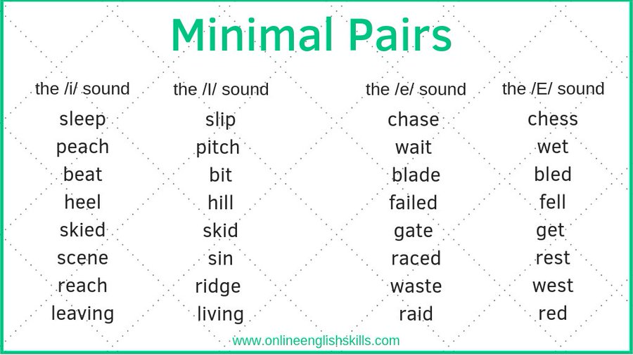
HERE IS A LIST OF MINIMAL PAIR WORDS THAT FOCUS ON VOWEL SOUNDS:

Slide 13
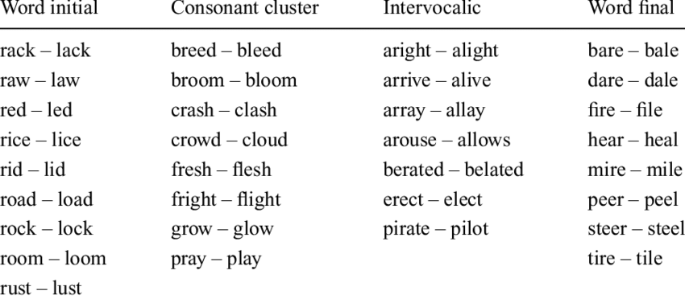
HERE IS A LIST OF MINIMAL PAIR WORDS THAT FOCUS ON VOWEL SOUNDS:

Slide 14
TONGUE TWISTERS – A TECHNIQUE TO IMPROVE PRONUNCIATION WITH THE HELP OF MINIMAL PAIRS
She sells seashells by the seashore.
Lily the lioness laughed at the ludicrous rabbits, but Rachel the rabbit rapidly ran around the rocks.
Harry the horse harmonized with the hummingbirds, but Angela the alligator anguished over the annoying ants.
Tommy the tiger tapped his toes, but Danny the dinosaur danced with delight.

Slide 15
MINIMAL PAIR CHORAL READING
Instructions: Read the following passages aloud with a partner or in a small group. Pay close attention to the minimal pairs in bold.
"The bat flew through the hat store, causing a big commotion. The store owner tried to catch the bat, but it flew away with a hat. Meanwhile, the cat sat on the mat, watching the whole scene with curiosity. The dog ran around the log, barking loudly."

Slide 16
MINIMAL PAIR CHORAL READING- PRACTICE
Instructions: Read the following passages aloud with a partner or in a small group. Find out the minimal pair and highlight them.
As I walked along the sea shore, I stumbled upon a quaint little tea shop. I decided to go in and try a cup of tea, but accidentally knocked over a sea salt container. The kite soared through the air, its bite-sized tail fluttering in the wind. Nearby, a pole stood tall next to a roll of colorful fabric."

Slide 17
MINIMAL PAIR CHORAL READING- PRACTICE
Answer: Minimal Pairs Highlighted
As I walked along the sea shore, I stumbled upon a quaint little tea shop. I decided to go in and try a cup of tea, but accidentally knocked over a sea salt container. The kite soared through the air, its bite-sized tail fluttering in the wind. Nearby, a pole stood tall next to a roll of colorful fabric."

Slide 18
MINIMAL PAIR CHORAL READING- PRACTICE
Instructions: Read the following passages aloud with a partner or in a small group. Find out the minimal pair and highlight them.
"After breaking the pane of glass, I had to find a new pen to write with. I quickened my pace as I walked to the store, trying to make it before closing time. As I rode my bike, I thought about the upcoming road trip with friends. We would drive for hours, enjoying the scenic views along the way."

Slide 19
MINIMAL PAIR CHORAL READING- PRACTICE
Answer: Minimal Pairs Highlighted
"After breaking the pane of glass, I had to find a new pen to write with. I quickened my pace as I walked to the store, trying to make it before closing time. As I rode my bike, I thought about the upcoming road trip with friends. We would drive for hours, enjoying the scenic views along the way."

Slide 20
By focusing on the subtle differences between minimal pairs, learners can improve their phonetic awareness, pronunciation, and overall language skills.

Slide 21
THANK YOU

